Slide 1
♦
DEVA AQUA SOLUTIONS
Authorized Global Brands Portfolio
ENGINEERING EXCELLENCE
OFFICIAL CORPORATE CATALOGUE
Complete Water & Wastewater
Management Systems
Single-source engineered solutions for luxury residential, commercial, industrial,
and institutional infrastructure.
AUTHORIZED KEY BRANDS
3M GRUNDFOS KEHEMS SUSBIO HULIOT

Slide 2
CORPORATE ARCHITECTURE
Integrated Water Loop Solutions
▼
◉
♻
Purification & Softening
Smart Pressure & Heating
Recycling & Quiet Drainage
Whole-house scale elimination and precision point-of-entry chemical filtration.
Constant pressure boosting paired with 70% energy-saving heat pumps.
Zero-odor biological STP recycling and UltraSilent soundproof piping.

Slide 3
AUTHORIZED DISTRIBUTORSHIP
World-Class Brand Alliances
3M
GRUNDFOS
KEHEMS
SUSBIO
HULIOT
Water Treatment
Pressure Boosters
Heat Pumps
Packaged STP
Acoustic Pipes
Whole house softeners & scale defense filters.
Smart variable speed constant pressure pumps.
High-efficiency centralized hot water generators.
Prefabricated eco-friendly sewage recycling tanks.
UltraSilent soundproof PP drainage systems.

Slide 4
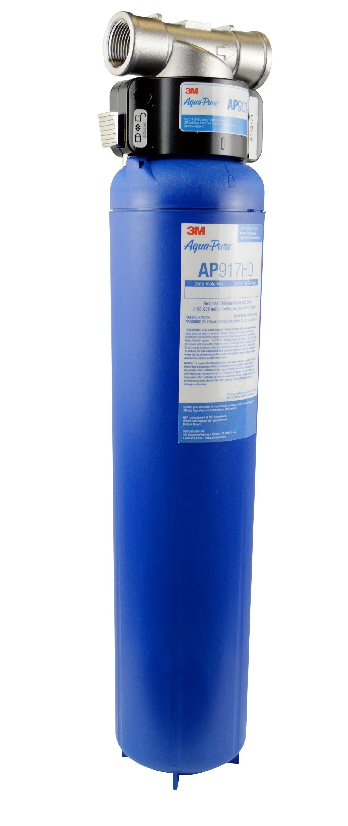
POINT-OF-ENTRY PURIFICATION
3M™ Home Water Solutions
Automatic Softeners: Food-grade ion resin prevents limescale.
AP Series Central Filters: Removes chlorine, rust, and heavy sediment.
ScaleGard Technology: Salt-free anti-scaling for hot geysers.
Under-Sink Drinking RO: Pure drinking water with essential minerals.

Slide 5
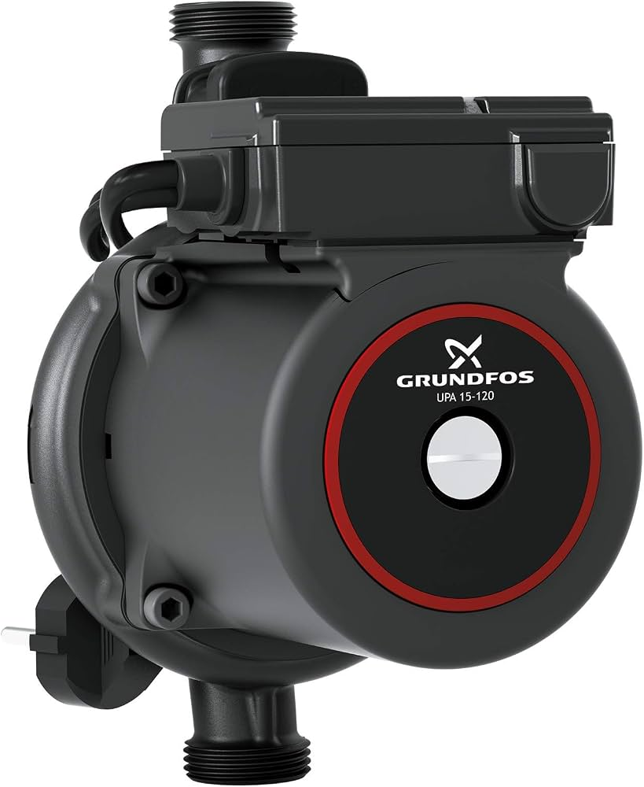
SMART HYDRAULICS
Grundfos Pressure Boosters
SCALA2 Booster: Perfect constant water pressure across all shower taps.
CMBE Commercial: Multi-story hydro-pneumatic water delivery.
DWK Dewatering: Heavy-duty submersible drainage & sewage pumps.
Hot Recirculation: Instant hot water with zero tap discharge waste.

Slide 6
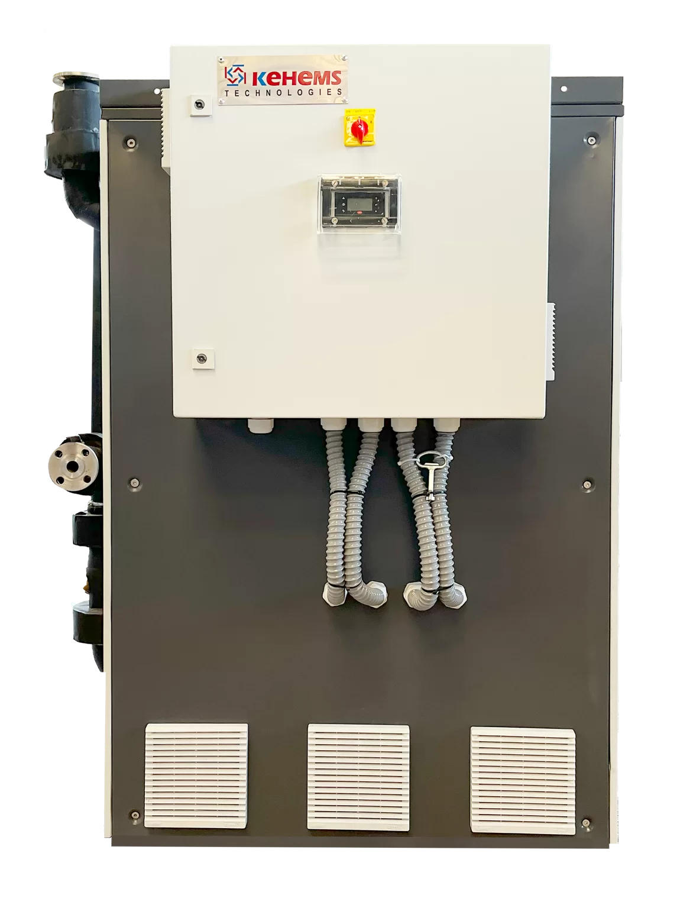
THERMAL INNOVATION
Kehems Commercial Heat Pumps
70% Energy Reduction: Extracts atmospheric heat for bulk hot water.
65°C Temperature Output: Bulk hot water for hotels & hospitals.
Pool Heating Systems: Titanium exchangers for all-season climate control.
All-Weather Operation: Reliable thermal output even in winter ambient drops.

Slide 7

ECO-FRIENDLY WASTEWATER
Susbio Packaged STP Tanks
Modular Prefab Tanks: Compact underground or above-ground FRP units.
MBBR Bio-Purification: Odor-free biological wastewater treatment.
Flush-Ready Effluent: Clear recycled water for gardening & flushing.
CPCB Compliant: Fully automated low-power plug-and-play operation.

Slide 8

ACOUSTIC PLUMBING
Huliot Soundproof PP Pipes
UltraSilent™ Tech: Multi-layer polypropylene suppresses drainage noise.
95°C Thermal Endurance: High temperature continuous waste discharge.
Chemical Shield: Resists aggressive cleaning agents and soil acidity.
Push-Fit Jointing: Elastomeric ring seals for flame-free installation.

Slide 9
TECHNICAL INTEGRATION
End-to-End Fluid Loop Matrix
Stage
Partner Brand
Primary Technology
Deliverable Value
1. Inflow Filtration
3M
Ion Exchange Resin
Limescale-free soft water
2. Pressure Boosting
GRUNDFOS
Variable Speed Motors
Constant shower pressure
3. Hot Water Generation
KEHEMS
Air Source Heat Pump
70% power reduction
4. Acoustic Drainage
HULIOT
Multi-layer Polypropylene
Whisper-quiet flow
5. Wastewater Reuse
SUSBIO
MBBR Bio-Reactor
Flush-ready clear water

Slide 10
MARKET SEGMENTS
Tailored Industry Solutions
⌂
▦
✚
▥
Luxury Residential
Hospitality & Resorts
Healthcare & Labs
Industrial Infrastructure
High-end villas and gated multi-story apartment communities.
Central hot water, silent plumbing, and high-pressure taps.
Sterile water purification and high-capacity STP treatment.
Process water pumping, dewatering, and fluid recirculation.

Slide 11
LIFECYCLE SUPPORT
Turnkey Execution Protocol
01
02
03
04
Water Audit
Custom Design
Supply & Fit
Commission & AMC
Testing incoming chemical parameters and pressure metrics.
Engineering tailored equipment for optimal yield and efficiency.
Precision installation using genuine OEM components.
System testing and long-term preventive maintenance support.

Slide 12
♦
Partner With Deva Aqua Solutions
Authorized Global Dealer • 3M • Grundfos • Kehems • Susbio • Huliot
✉ admin@devaqua.in ◉ www.devaqua.in

